Slide 1






PROJECT
JULIE LERVAAG BREIVIK

Slide 2


AGENDA
PROJECT DESCRIPTION
WORKFLOW & PROCESS
RESULTS OF THE PROJECT
CHALLENGES
LESSONS LEARNED

Slide 3


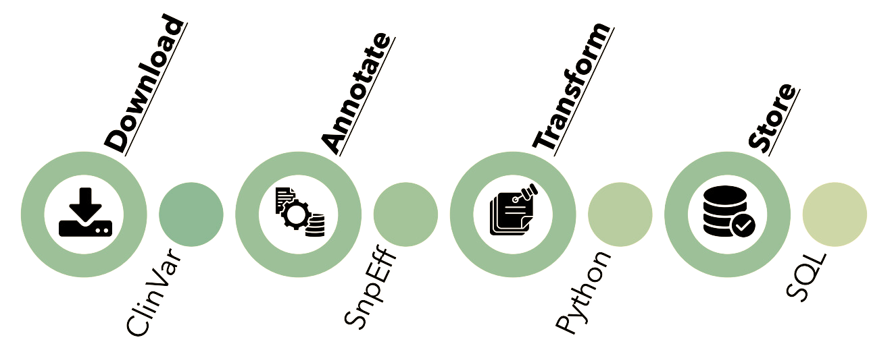

PROJECT DISCRIPTION
THIS PROJECT AIMS TO DEMONSTRATE THE PROCESS OF TRANSFORMING GENOMIC DATA INTO A UNIFIED MODEL FOR EFFICIENT MANAGEMENT AND ANALYSIS OF KNOWLEDGE.

Slide 4





WORKFLOW
DEFINE ISSUES AND BRANCHES
WORKING IN USING GITHUB
TRIED TO ENSURE A STABLE WORKLOAD & KEEP A NICE AND STABLE PROGRESS

Slide 5


UNDERSTANDING
THE TASK
WHAT IS A VCF FILE?
WHAT IS ANNOTATION ?
WHAT IS SNPEFF?

Slide 6


ANNOTATED FILE
#CHROM POS ID REF ALT QUAL FILTER INFO FORMAT CLINGEN
11 108198392 . T TA . PASS . GT ./.
11 108198392 . T TA . PASS ANN=TA|frameshift_variant|HIGH|ATM|ENSG00000149311|transcript|ENST00000278616|protein_coding|48/63|c.6997dupA|p.Thr2333fs|7383/13147|6998/9171|2333/3056||INFO_REALIGN_3_PRIME,TA|frameshift_variant|HIGH|ATM|ENSG00000149311|transcript|ENST00000452508|protein_coding|49/64|c.6997dupA|p.Thr2333fs|7187/12954|6998/9171|2333/3056||INFO_REALIGN_3_PRIME,TA|downstream_gene_variant|MODIFIER|C11orf65|ENSG00000166323|transcript|ENST00000527531|nonsense_mediated_decay||n.*5171dupT|||||3533|,TA|downstream_gene_variant|MODIFIER|C11orf65|ENSG00000166323|transcript|ENST00000524755|protein_coding||c.*3884dupT|||||3745|WARNING_TRANSCRIPT_NO_START_CODON,TA|intron_variant|MODIFIER|C11orf65|ENSG00000166323|transcript|ENST00000525729|protein_coding|6/6|c.641-18595dupT||||||,TA|non_coding_transcript_exon_variant|MODIFIER|ATM|ENSG00000149311|transcript|ENST00000524792|retained_intron|22/37|n.3212dupA||||||INFO_REALIGN_3_PRIME,TA|non_coding_transcript_exon_variant|MODIFIER|ATM|ENSG00000149311|transcript|ENST00000533690|retained_intron|16/22|n.2401dupA||||||INFO_REALIGN_3_PRIME,TA|non_coding_transcript_exon_variant|MODIFIER|ATM|ENSG00000149311|transcript|ENST00000525537|retained_intron|1/2|n.273dupA||||||INFO_REALIGN_3_PRIME,TA|non_coding_transcript_exon_variant|MODIFIER|ATM|ENSG00000149311|transcript|ENST00000527389|retained_intron|1/2|n.23dupA||||||INFO_REALIGN_3_PRIME;LOF=(ATM|ENSG00000149311|25|0.08) GT ./

Slide 7
WHY ANNOTATE
- understanding how genetic variants might contribute to diseases, especially genetic disorders where protein function is critical.
-> help researchers and clinicians make informed decisions about potential genetic risks + treatment strategies.

Slide 8
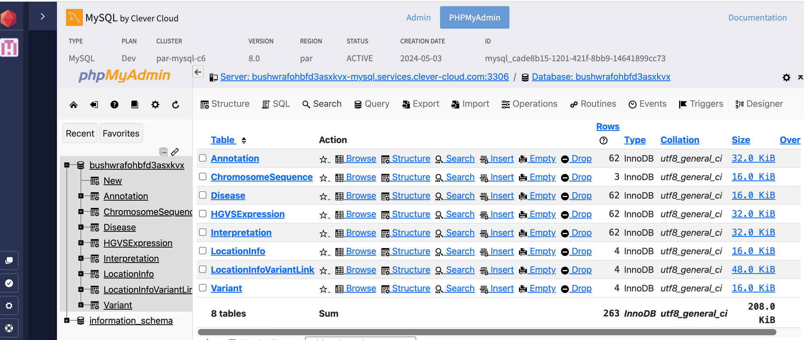
RESULTS

Slide 9
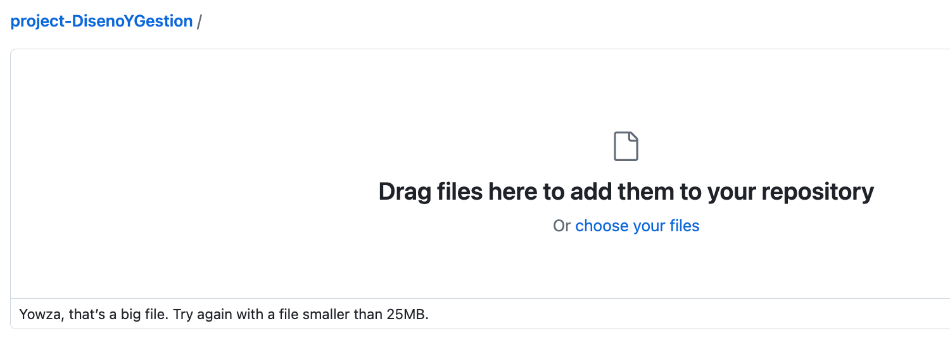


1
Data Volume and Complexity:
Did run the whole code with the normal
file in the beginning
3
-SET OF GENOMIC DATABASES FROM:
• CLINVAR: HTTPS://FTP.NCBI.NLM.NIH.GOV/PUB/CLINVAR/VCF_GRCH37/CLINVAR.VCF.GZ
2
Vicely divide my code,
Lack of domain knowledge. Hard to see the value of data
CHALLANGES

Slide 10




LESSIONS LEARNED
UNDERSTAND
ASK
TEST
KNOW THE DOMAIN
PLAN THE PROJECT
WORK STRUCTURED

Slide 11

THANKS FOR YOUR ATTENTION

